Slide 1


DEEP LEARNING
FINAL PROJECT
Pokemon classifier
Hosted By:
Hadas Abraham and Dor Malka

Slide 2


AGENDA
03
Project Overview
04
Project Results: Determine the model
05-09
Project Results: Transfer-Learning
10-12
Project Results: Self-Supervised Learning
13
Project Retro: What Went Well
14
Project Retro: What Did Not Go Well

Slide 3
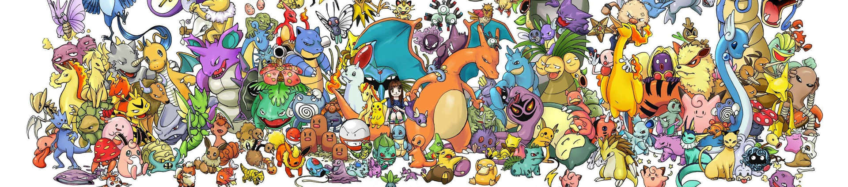
Project Overview
Project Goal
The goal of this project is to develop a deep learning model capable of accurately detecting and identifying Pokémon characters in images. By leveraging the power of convolutional neural networks (CNNs), the model will learn to recognize unique visual patterns and features associated with different Pokémon species, enabling it to accurately classify and locate Pokémon within images. Furthermore, after classify our network will produce and show on-the-fly some interesting and fun facts about the Pokémon.

Slide 4
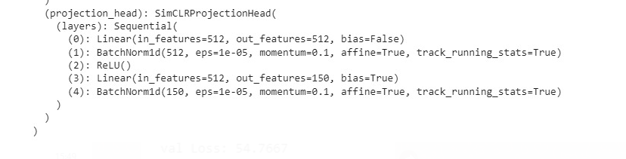
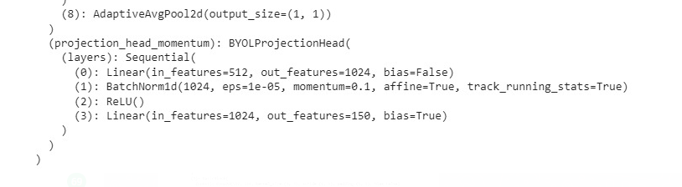
Project Results
Determine the Model
To determine the model we used 2 approaches:
Transfer learning - using VGG pre-trained model
Self-Supervised Learning - train and test numerous models: BYOL, SimCLR, Dino, SimSiam

Slide 5
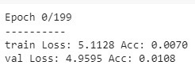
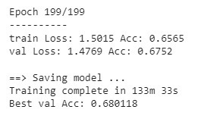
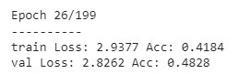


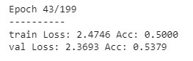
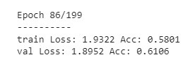
Project Results
Determine the Model
Transfer learning - using VGG pre-trained model

Slide 6
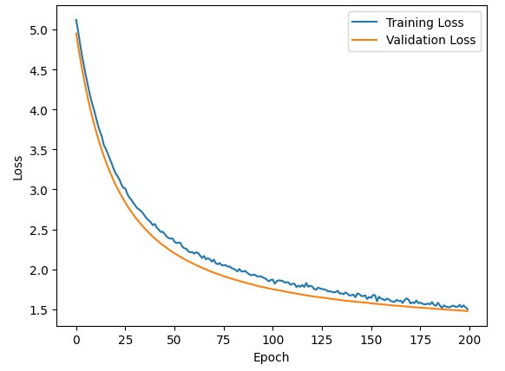
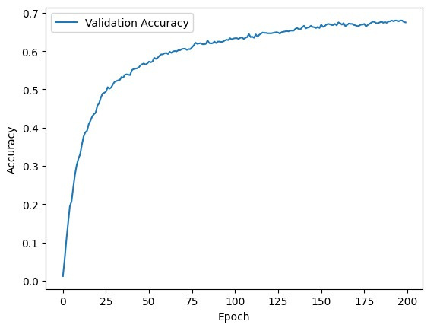
Project Results
Determine the Model
Transfer learning - using VGG pre-trained model
Train-loss vs Val-loss
validation accuracy

Slide 7

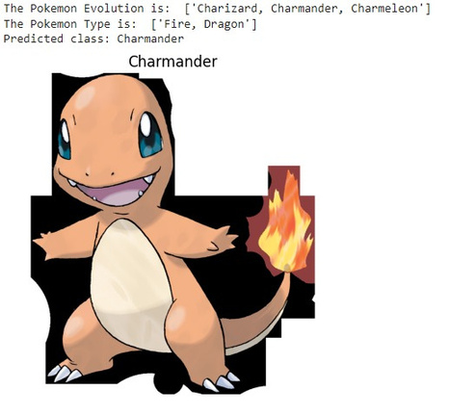
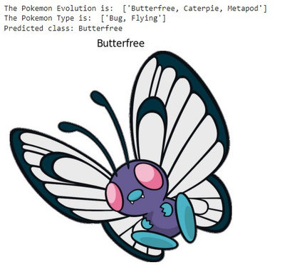
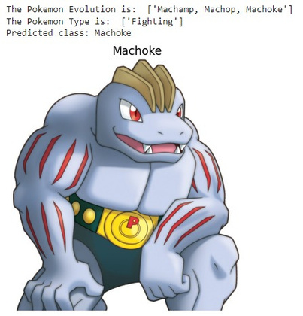
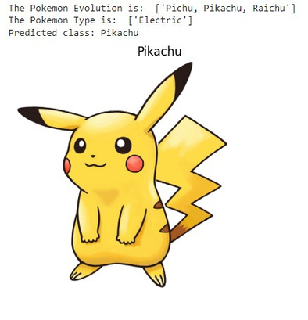
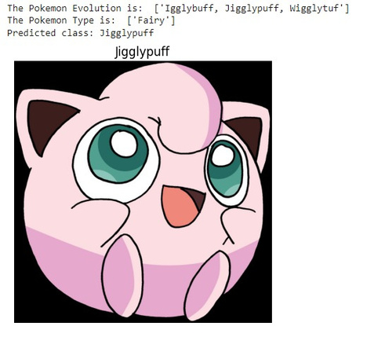
Project Results
Determine the Model
Transfer learning - using VGG pre-trained model

Slide 8

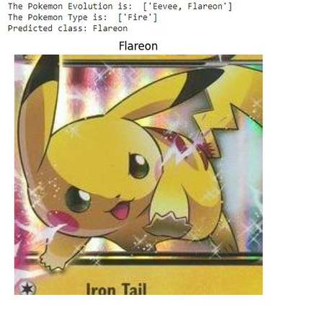
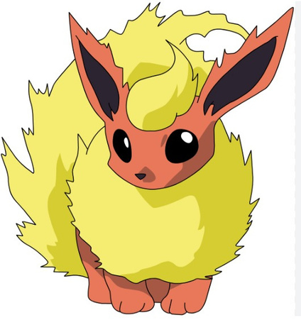
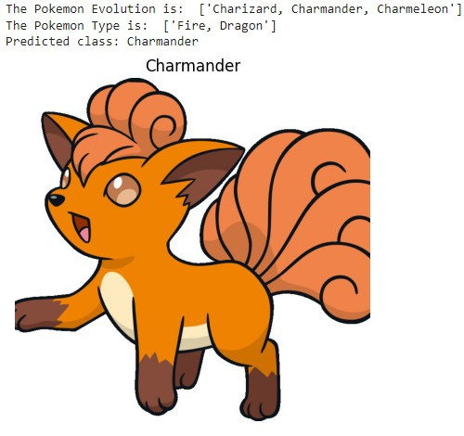

Project Results
Determine the Model
Transfer learning - using VGG pre-trained model
The focus on incorrectly predicted Pokémon within the same evolution line highlights potential areas for further improvement or exploration in future iterations of the model.

Slide 9
Project Results
Conclustions 1
Transfer learning - using VGG pre-trained model
Test Accuracy: The model achieved a test accuracy of 68%, indicating its ability to make correct predictions on unseen data.
Intra-Evolution Line Errors: It was observed that a significant number of incorrect predictions were made for Pokémon within the same evolution line. This suggests that the model had difficulty distinguishing between closely related Pokémon within the same evolutionary family.
Challenging Dataset: The dataset used for training and testing the model consisted of 150 classes, some of which were very similar. Despite this challenging aspect of the dataset, the model still performed well, considering the number of classes and the similarities between them.

Slide 10


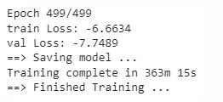
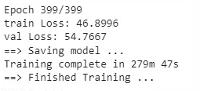
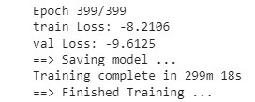
Project Results
Determine the Model
Self-Supervised Learning - train and test numerous models: BYOL, SimCLR, Dino, SimSiam
We chose those models based on accuracy and runtime trade-off as in Fig at tutorial 9.
All architectures used resnet18 as a backbone
Each model has its own loss function
The fastest: BYOL
The slowest: Dino
BYOL
SimCLR
SimSiam
Train

Slide 11
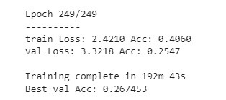
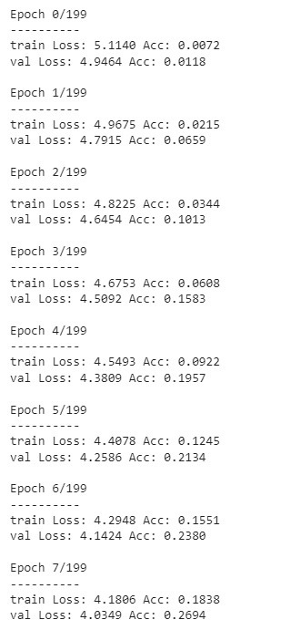
SimCLR Results
SimSiam Results
BYOL Results
DINO Results
Require gradient problem
Was too slow each epoch took approximately ~8 minutes

Slide 12
Project Results
Conclustions 2
Self-Supervised Learning - train and test numerous models: BYOL, SimCLR, Dino, SimSiam
Test Accuracy: The models achieved a test accuracy of 30%, indicating their low ability to make correct predictions on unseen data.
Performance Comparison: When compared to the pre-trained VGG model, all the self-supervised learning models trained on the dataset showed insufficient results.
Challenging Dataset: The dataset used in the experiment presented significant challenges, which affected the accuracy of the self-supervised learning models.
Inadequate Accuracy: The self-supervised learning models did not achieve the desired level of accuracy, falling short of expectations.

Slide 13
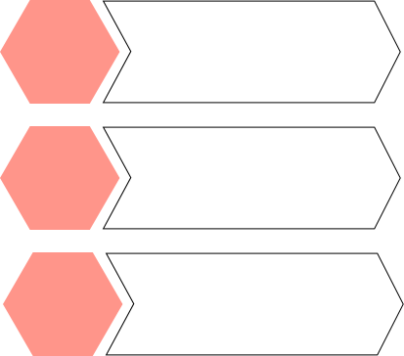
Selecting hyperparam-eters
Analyzing both the VGG and the self-supervised models' parameters and determining the best parameters for our useage using the Random search technique.
Understand the models architecture
we examine the architecture of each Self-Supervised Learning model that we chose and adjust it to our goals
What Went Well
By experimenting with various models we could compare different behaviors, this approach helped us to overcome model-choosing mistakes and better comprehend the model chosen.
Comparing models

Slide 14
The best model based on the Fig in tut.10 Dino, was computationaly heavy, we try to run it but each epoch took a lot of time
Limitted Resourses
Our classification problem included 150 Pokemon species classes with ~30 images each. Moreover, some species are very similar.
What Did Not Go Well
Limitted Datasets
We trained a lot of hours BYOL model and save checkpoints and realized that this model doesn't save its last layer gradient. this prevents us from using it as pre-train and reshape the last layer
Selecting Model

Slide 15

Thank you for listening!

